Slide 1
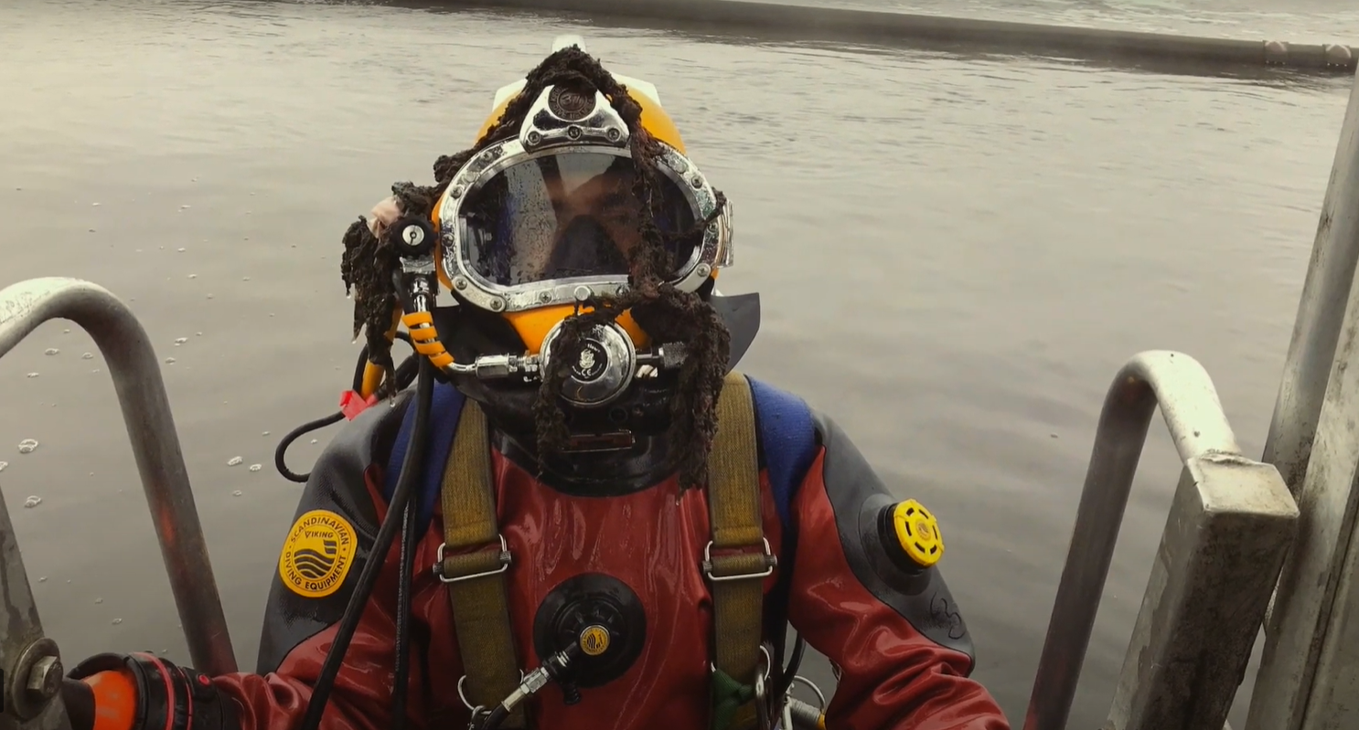
Dive Deeper

Slide 2
Learning intentions
  For students to
Understand that the use of science and technology to address issues such as water shortages, may have social and ethical implications
Investigate other cities that already use recycled water

Slide 3
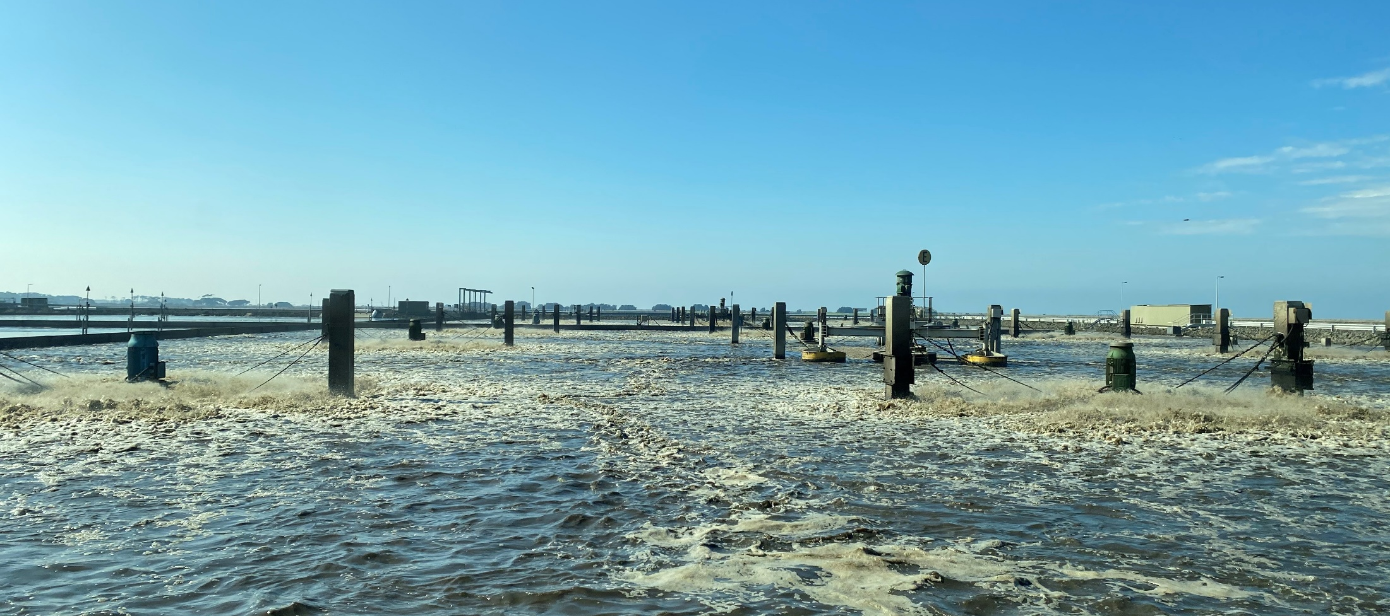
Starter: Could you get over the ‘yuck’ factor and drink purified recycled wastewater?

Slide 4
Case study: Toowoomba
In the mid 2000s, the residents of Toowoomba in south-east Queensland were struggling through the Millennium Drought and some of the toughest water restrictions in the country.
Water restrictions began in 2003 and by 2006 the town was on level 4 water restrictions, lawns were brown and cars were dusty. Water storage levels were at 20% and were predicted to drop to 5% within two years. There was no sign of the drought ending.

Slide 5
Case study: Toowoomba
In July 2005 the Toowoomba council announced a number of water solutions, including the building of a waste treatment plant to add recycled sewage that was drinking quality to the town’s water stores.
Within a month a campaign group had formed to oppose the proposal. For almost a year the community debated the proposal and progress stalled.
In March 2006, the federal government announced that the residents of Toowoomba would be given an opportunity to vote on the proposal.
The Toowoomba local council objected to the referendum. They argued that they had been elected to represent the community and make decisions on their behalf.

Slide 6
Case study: Toowoomba
Leading up to the referendum, the campaigning on both sides was intense across radio, television and print media.

Slide 7
Task: Analyse the media campaign and complete the table
Source | What is the message of this source? | How does this source use text and images to persuade? | Would you find this persuasive?
1: Referendum polling day poster
2: Advertisement– A NO VOTE and a YES VOTE
3: Car Sticker
Other:

Slide 8
Sources
Source 1: Referendum polling day poster
Source: https://www.brisbanetimes.com.au/politics/queensland/critics-pooh-poohed-water-scheme-but-ex-mayor-says-sewage-is-solution-20210204-p56zp8.html
Source 2: Advertisement– A NO VOTE and a YES VOTE
Source: https://www.qhatlas.com.au/photograph/anti-recycled-water-campaign-toowoomba
Source 3: Car Sticker
Source: http://thorley.blogspot.com/2006/07/toowoomba-motorist-demonstrates-no.html

Slide 9
Case study: Toowoomba
On the 29th of July 2006, 62% of Toowoomba voters, voted against adding treated recycled waste water to the town’s water stores. 38% voted in favour.
Discuss: Are you surprised that the majority of people voted ‘no’?
Meanwhile the drought continued, and by April 2007, Toowoomba residents were living with level 5 water restrictions.
By 2010 the dams were down to 8%. Soon after a pipeline was opened that connected Toowoomba to a larger supply of water managed by the Queensland state government.
The Wivenhoe Dam pipeline provides security of supply when the rainfall in our dam catchments is insufficient to maintain supply to meet the region's growing needs. Once the capacity of Cressbrook dam falls below 40%, Toowoomba can start using water from Wivenhoe Dam.
This store of water is topped up with purified waste water during times of drought.

Slide 10
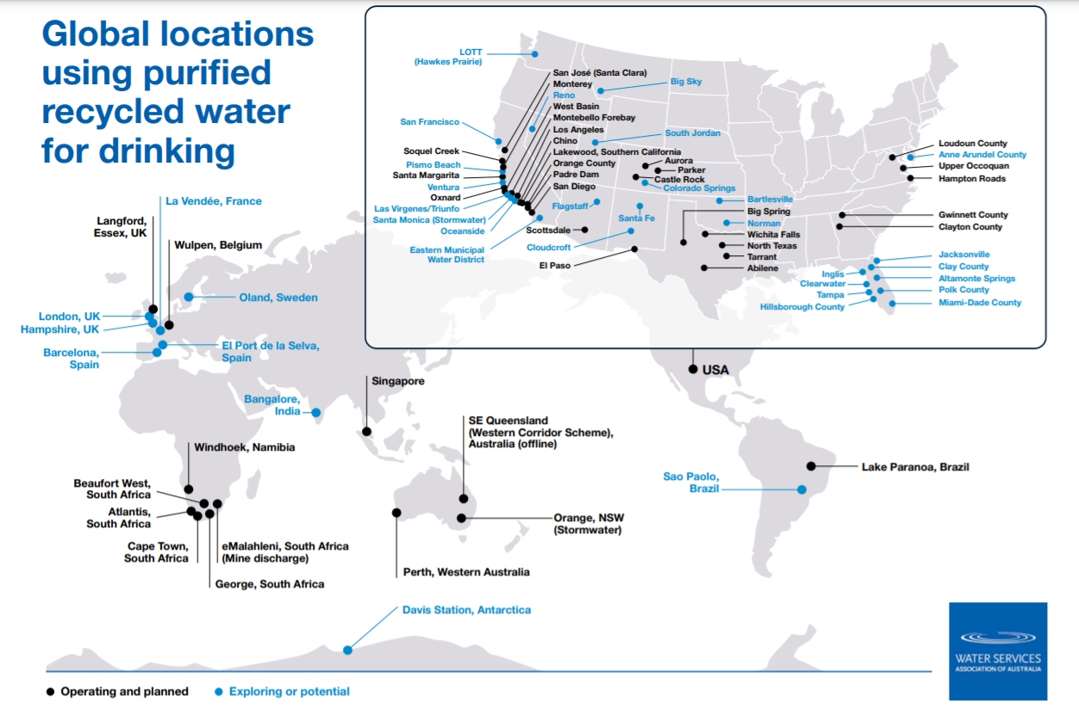
Task: Choose one city from the map to research
Find out:
1. When and why was recycled water proposed in this city?
2. How do they use recycled water?
3. What has been the public and media reaction to the use of recycled water?

Slide 11
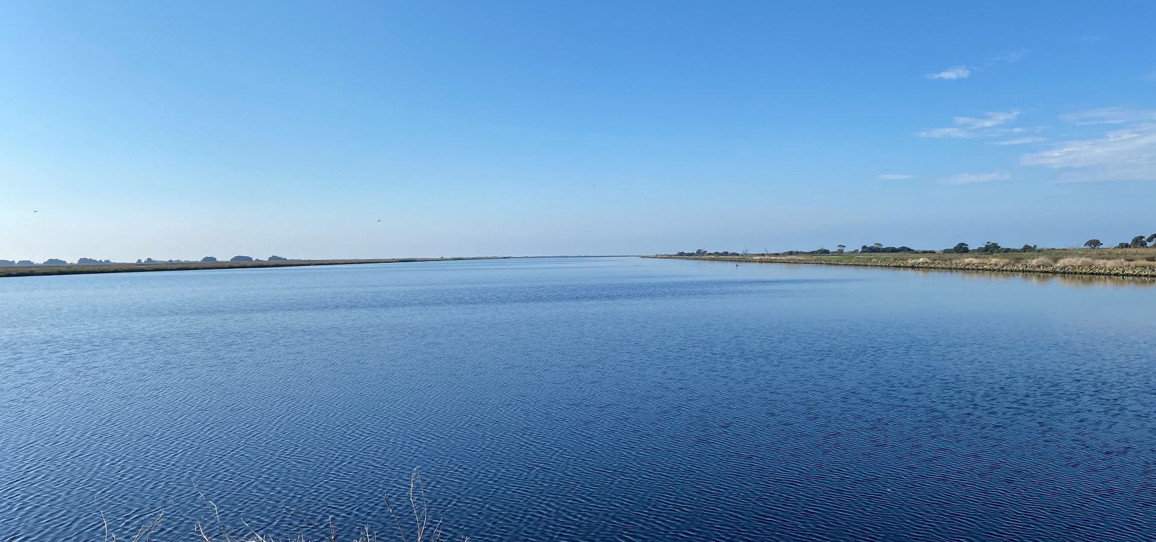
Plenary: Could you get over the ‘yuck’ factor and drink purified recycled water?

